Slide 1

---Money for Waste --- Utilisation of Construction & Demolition Waste and Agro Waste
Dr. Mahfooz Soomro
School of Computing, Engineering and Mathematics
Western Sydney University
AUSTRALIA

Slide 2
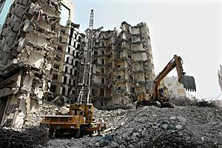
Objective
To reduce waste materials to their highest by improving and promoting their reuse & earn money.
To encourage the recycling and reuse of :
Construction & Demolition Waste
Agro Waste

Slide 3
Composition of Municipal Solid Waste (MSW)
Construction & Demolition Waste
Wood and Organic Waste
Metals (ferrous & non-ferrous)
Glass
Plastics
Paper
Electronics (key boards, computer screens, old Tv sets, HiFi)
Hazardous Waste (asbestos, construction chemicals , gypsum plaster board)
Composition of waste may vary from country to country due to cultural differences.

Slide 4
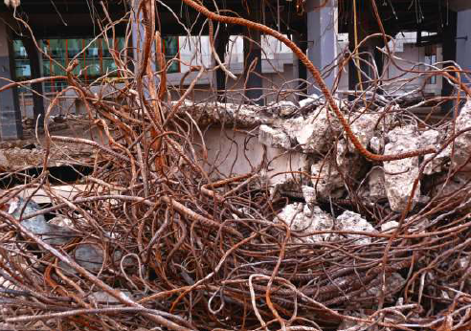
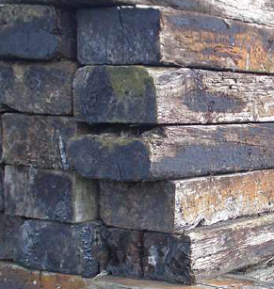
Composition of Construction & Demolition Waste
Soil and Sand
Bricks and Masonry
Concrete
Metal
Wood
Glass
Bitumen
Other

Slide 5
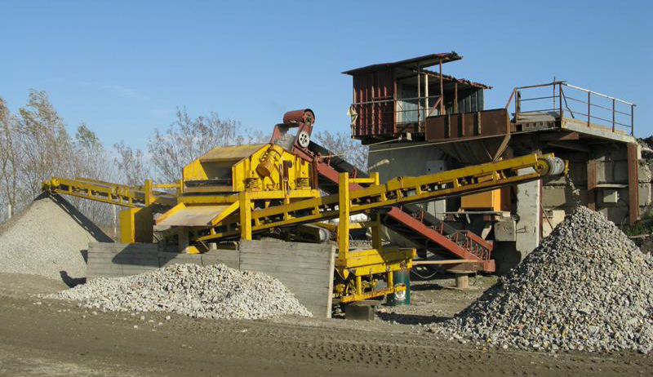
Concrete Recycling –
Recycled Aggregate Crushing plant

Slide 6
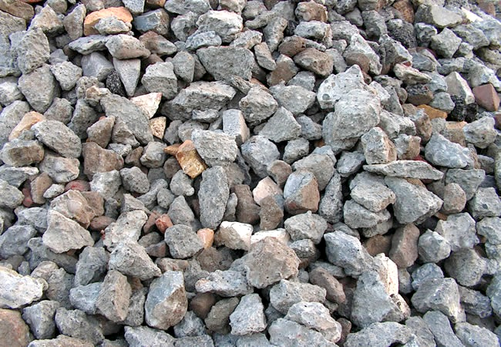
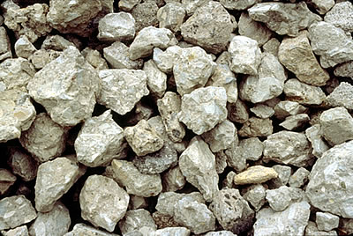
Recycled Aggregate
Natural Aggregate

Slide 7
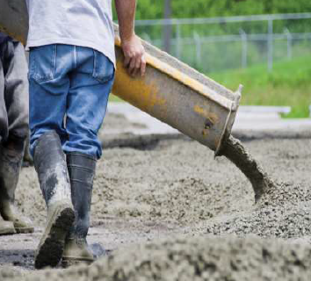
Benefits of recycling Construction & Demolition waste
Benefits of reducing concrete waste
Reduced cost of aggregate
Reduced consumption of natural resources
Reduced environmental degradation
Eliminates illegal dumping of Construction & demolition waste
Increased life span of landfills

Slide 8
Recycling of
Agro waste & Brick waste

Slide 9
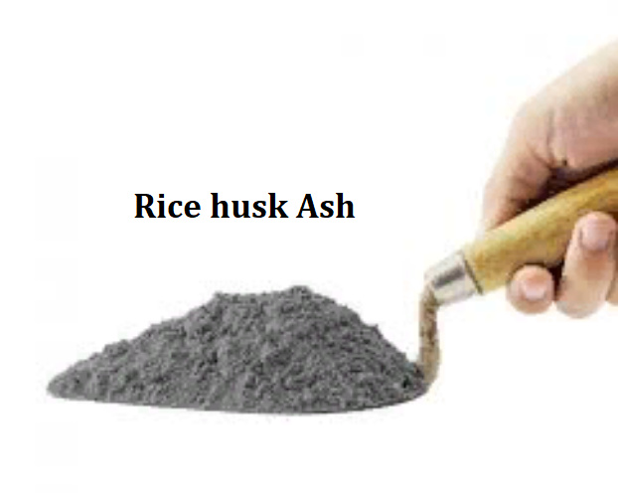
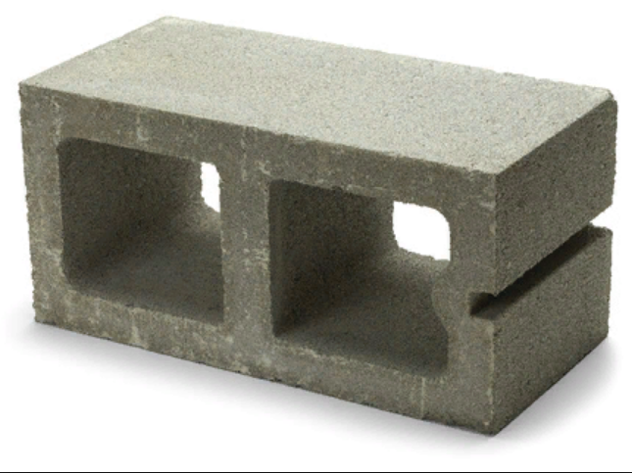
Recycling of Agro Waste

Slide 10
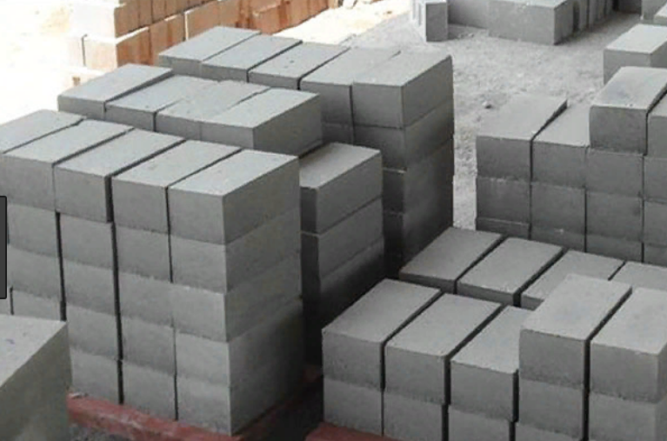
Recycling of Agro Waste & Coal Ash

Slide 11
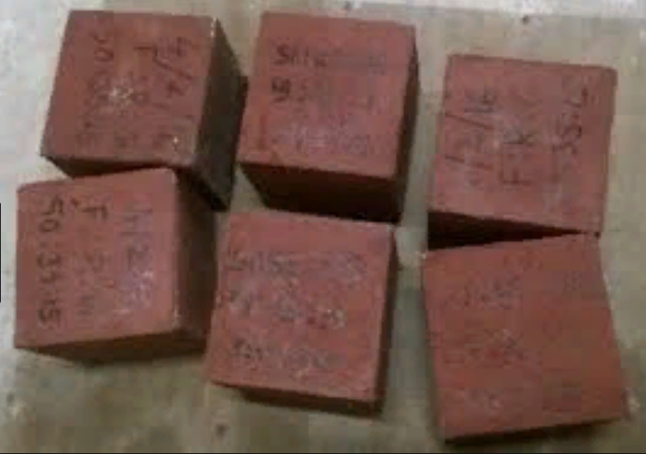
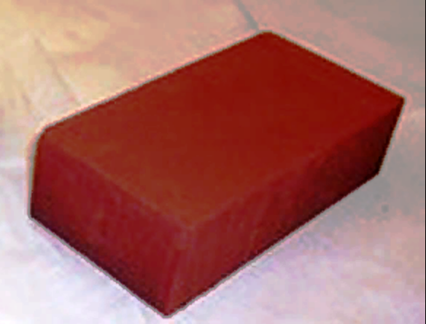
Recycling of Brick Waste

Slide 12
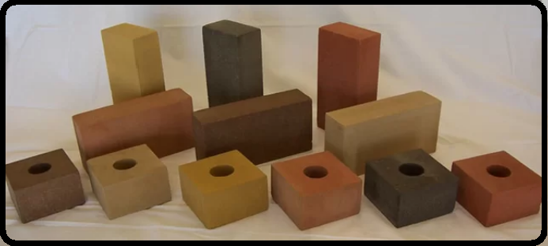
Recycling of Brick Waste

Slide 13
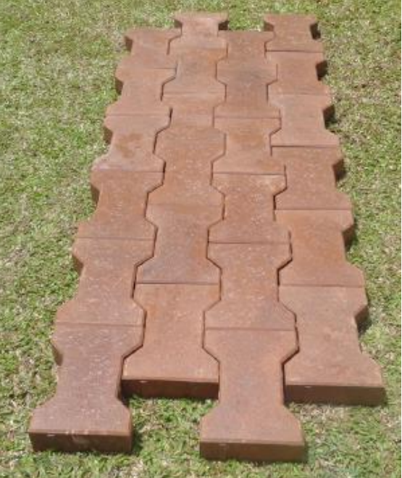
Pavers
made from
Coal ash &
Brick waste

Slide 14
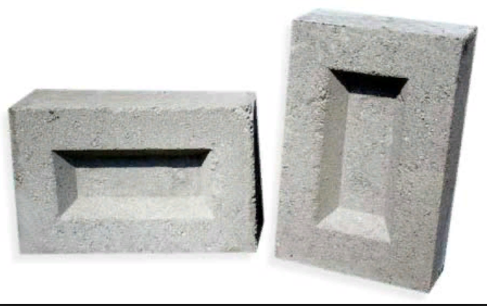
Coal ash / Bagasse ash Bricks

Slide 15
Benefits of recycling Construction & Demolition waste
Environmental Benefits :-
Prevents waste, reduces dependence on natural resources
Reduces pollution & CO2 emissions
Produced from (industrial & transportation)
Reduces energy and water required to produce building supplies from virgin materials.

Slide 16
Benefits of recycling Construction & Demolition waste
Cost Reduction Benefits:-
To take advantage of revenues derived from recycle, reuse and salvage materials.
Contractors & builders can make changes to their operations and practices.
They can adopt methods of reuse and salvage on the site to improve
Quality of recycled
materials,
Reduce quantity of
materials that
end up in landfills,
Create a cleaner and
safer project site.

Slide 17


Slide 18


